Slide 1
^{Ajith K B}
^{Turbo Intern}
^{Wipro}
3D Model Reconstruction
3rd Presentation

Slide 2
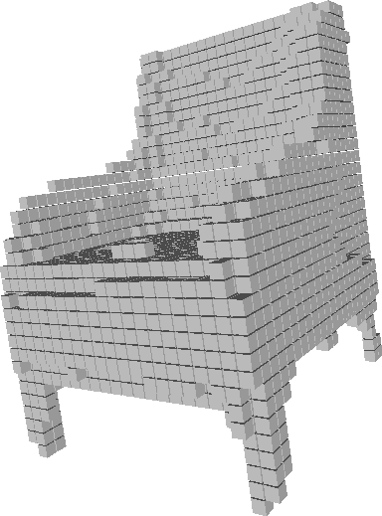




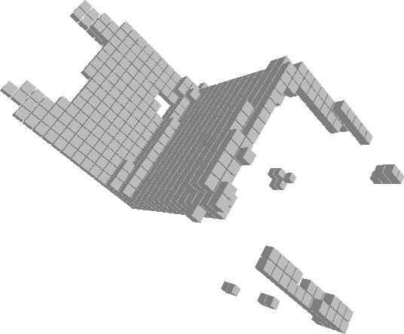



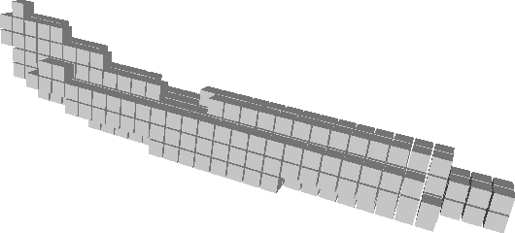


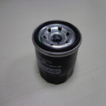
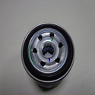
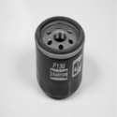
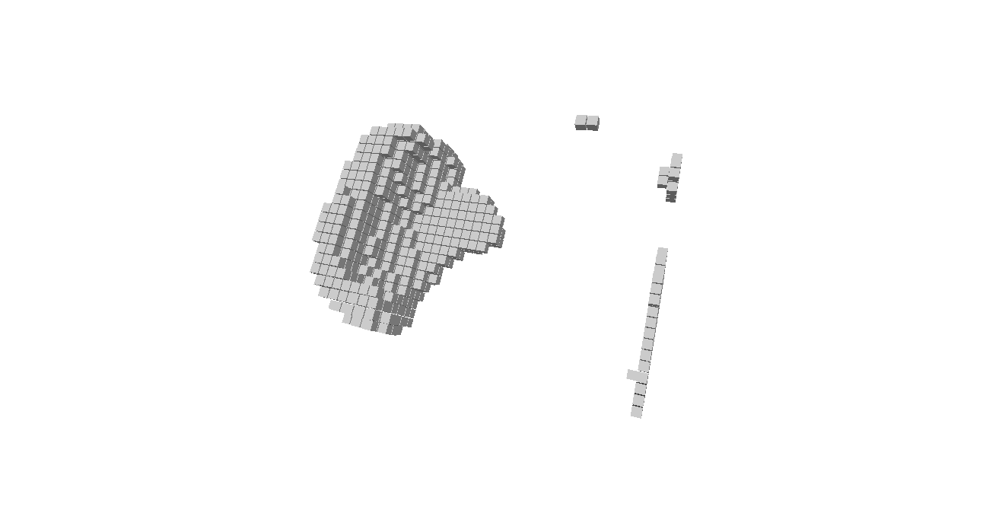
Method: 3D R2N2

Slide 3
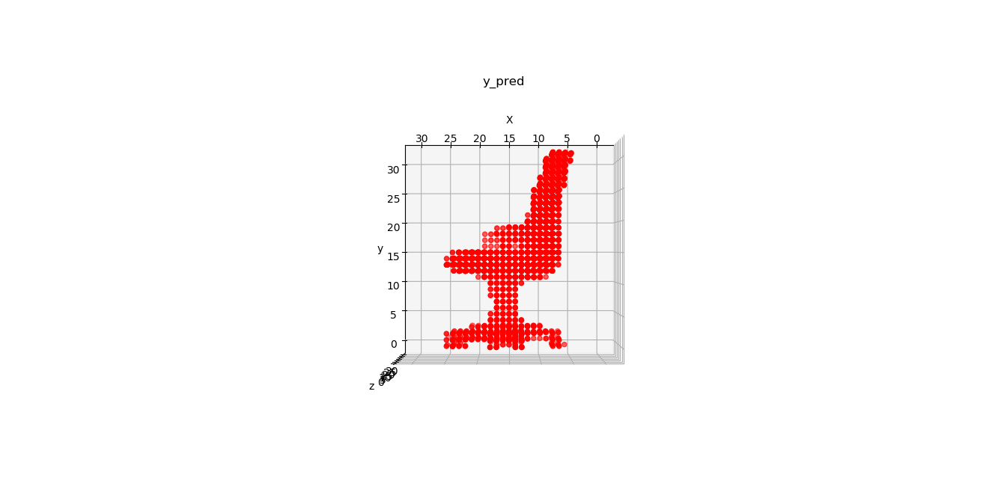
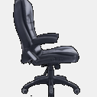
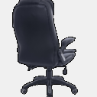
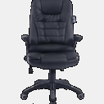
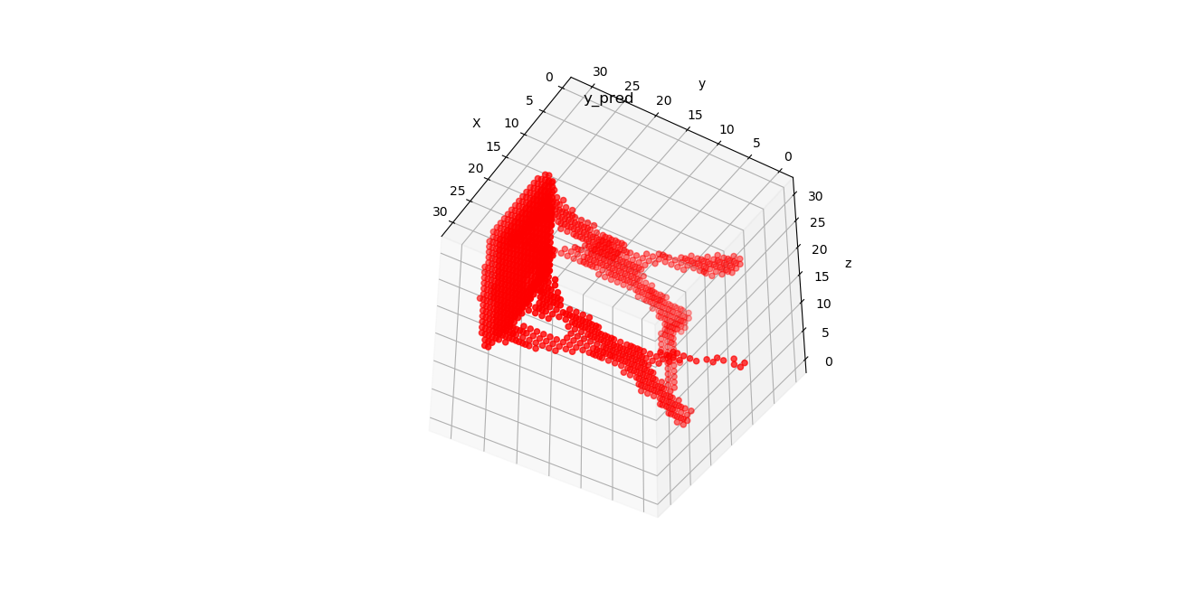
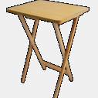
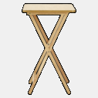
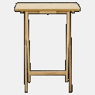
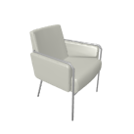
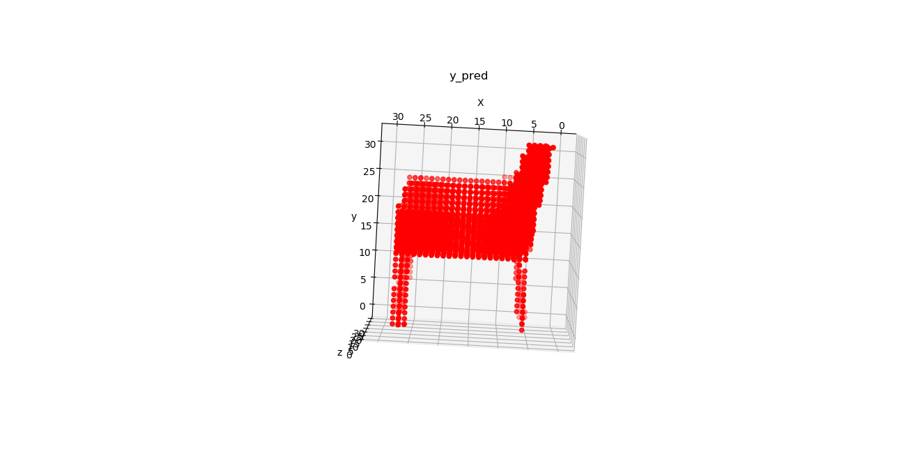
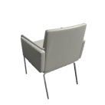
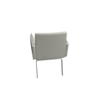

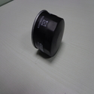
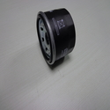
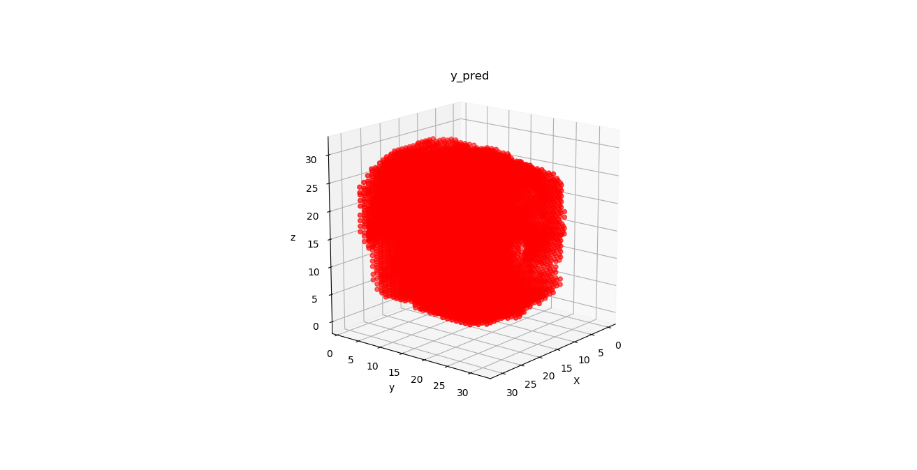
Method: Attsets

Slide 4
Network Comparison
Networks – 3D R2N2 , MVS , Attsets.
The Attsets network is permutation invariant & have better Accuracy
gradient vanishing in RNN models
High Information Content in Attsets.
Computation Efficiency
Generality and Robustness

Slide 5
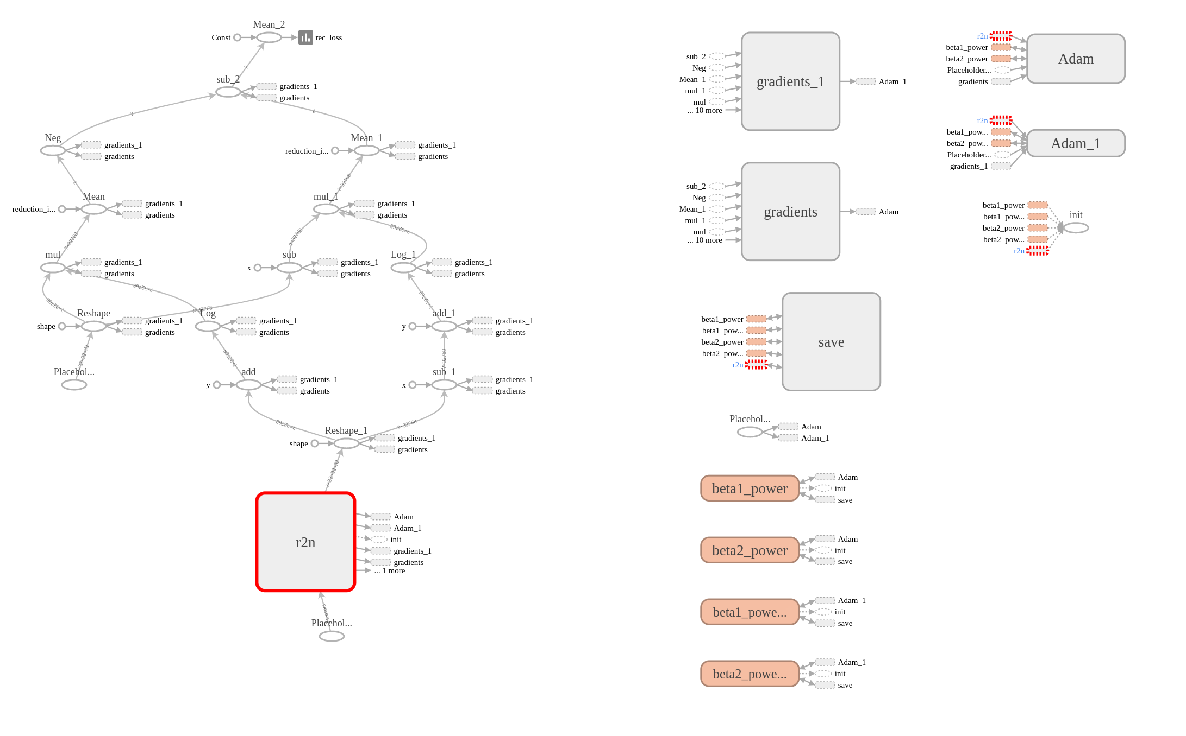
TensorBoard

Slide 6
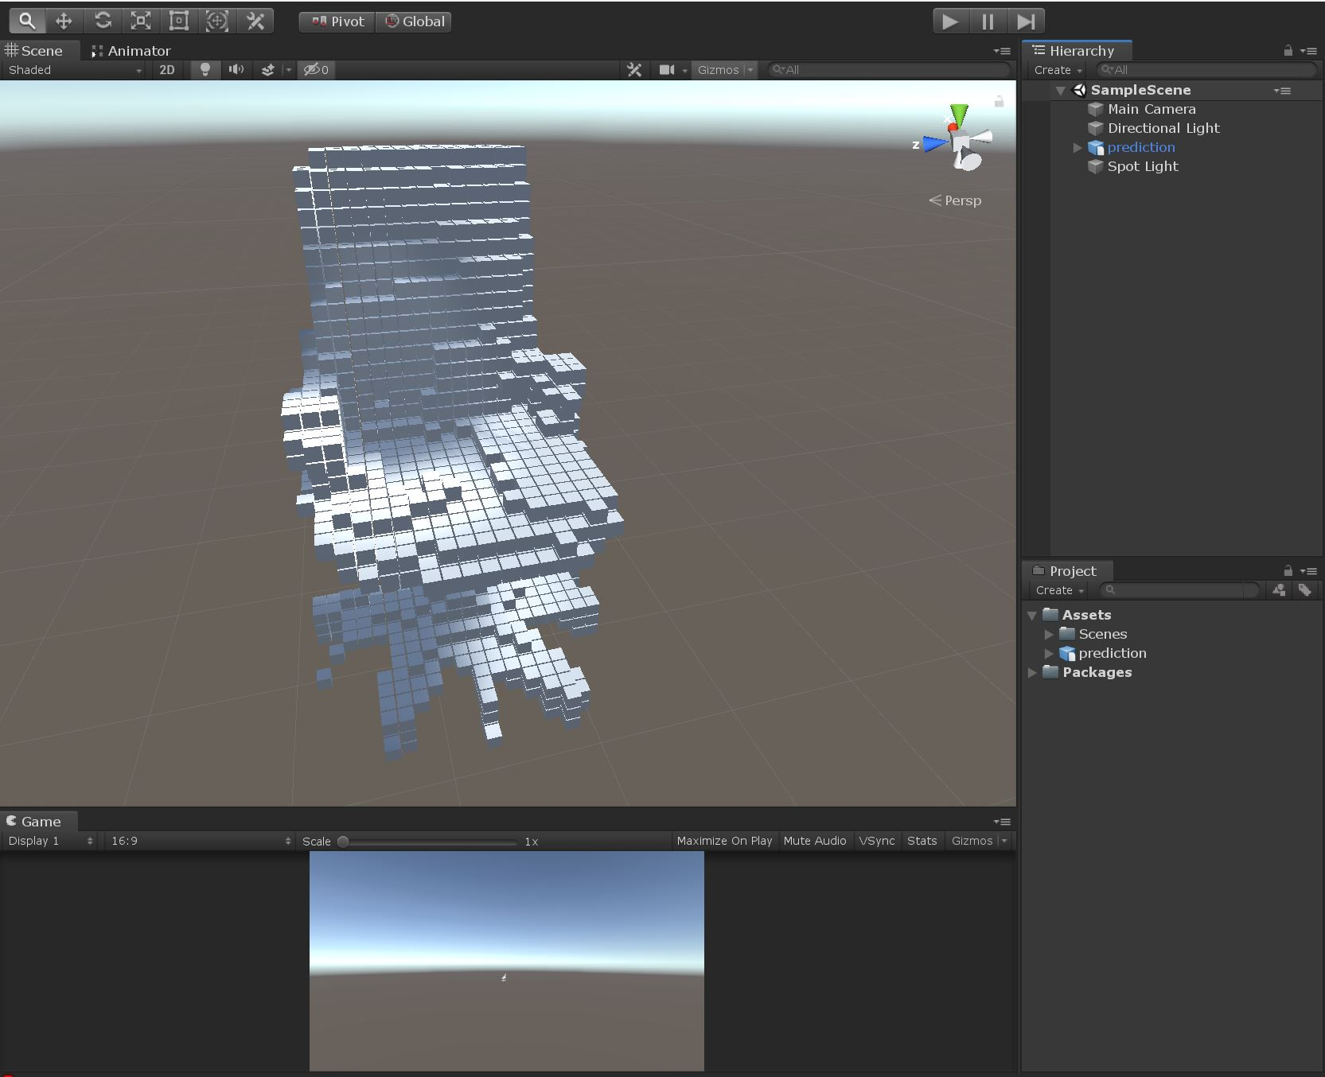
Voxelized Model Renderd In Unity

Slide 7
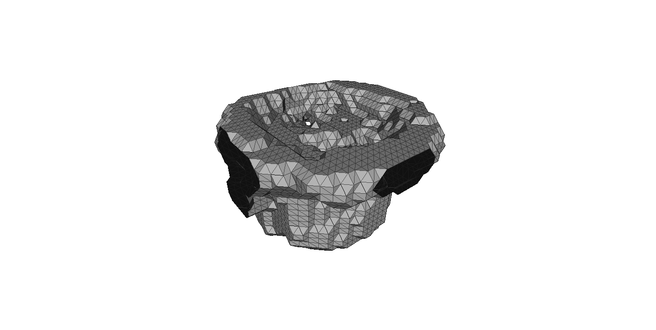
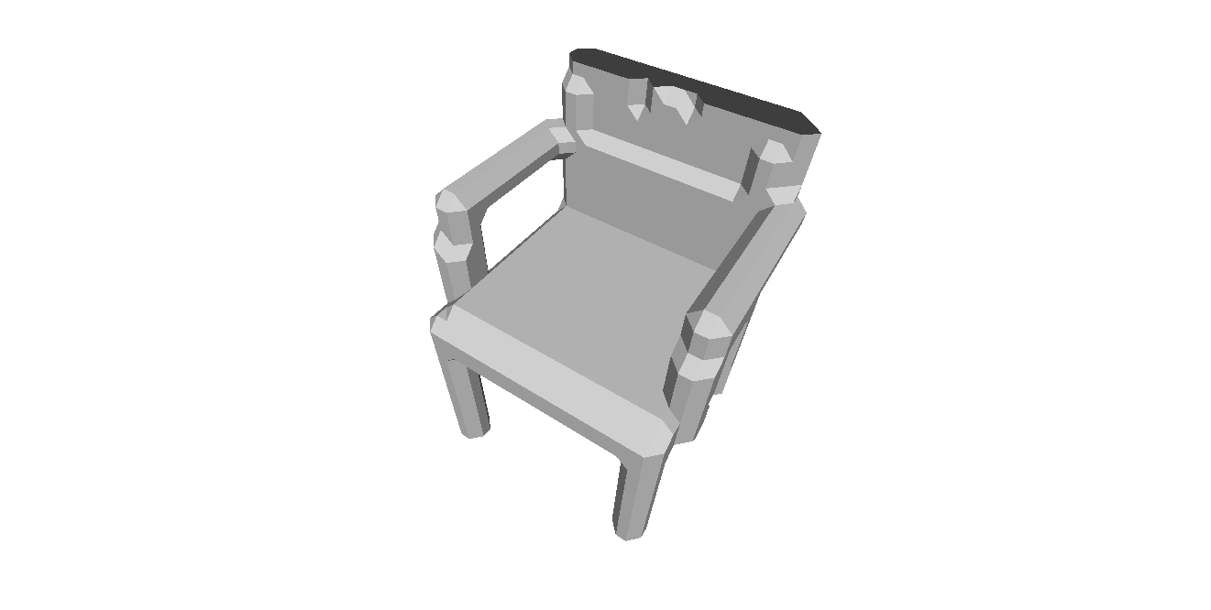
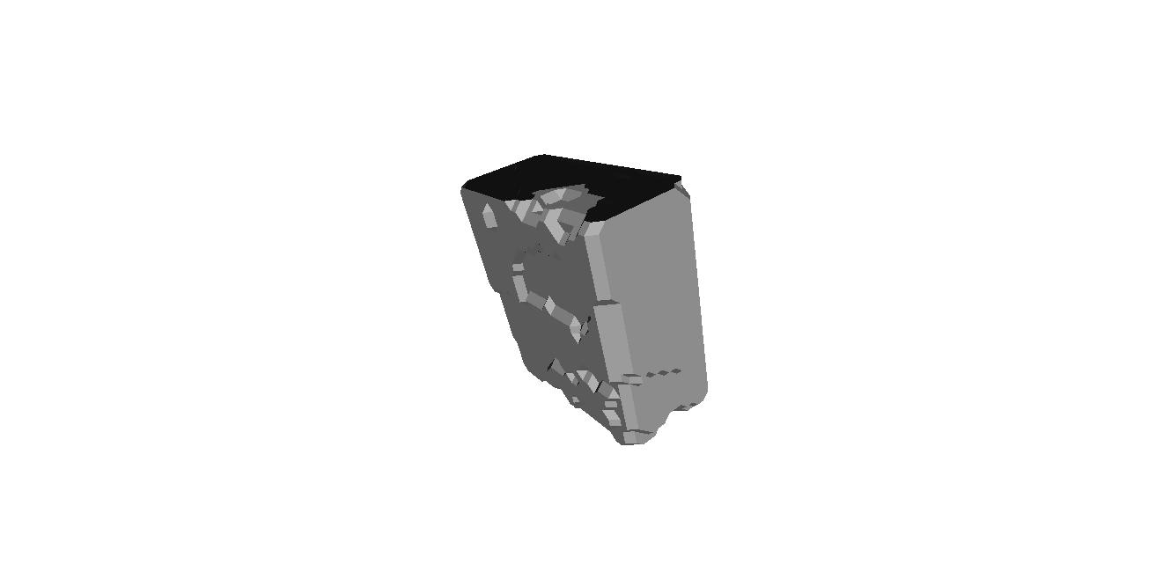
Surface Reconstruction
Surface reconstruction algorithm : Marching cubes
Out put file format : .OBJ and .DAE (Collada)

Slide 8
Next Step/challenges
Need To create our own dataset.
Need to create ground trouth models.
Refering – Shapenet dataset.
Need to improove the accuracy for live images.

Slide 9
Referances
http://svl.stanford.edu/assets/papers/choy_eccv_3dr2n2_16.pdf
https://pdfs.semanticscholar.org/8b0d/96ebad79c878f3fe71aadf216f6d57998ca5.pdf
https://arxiv.org/abs/1808.00758
http://shapenet.cs.stanford.edu/shapenet/obj-zip/ShapeNetCore.v2-old/shapenet/tex/TechnicalReport/main.pdf

Slide 10
Thank You

Slide 13


